Slide 1
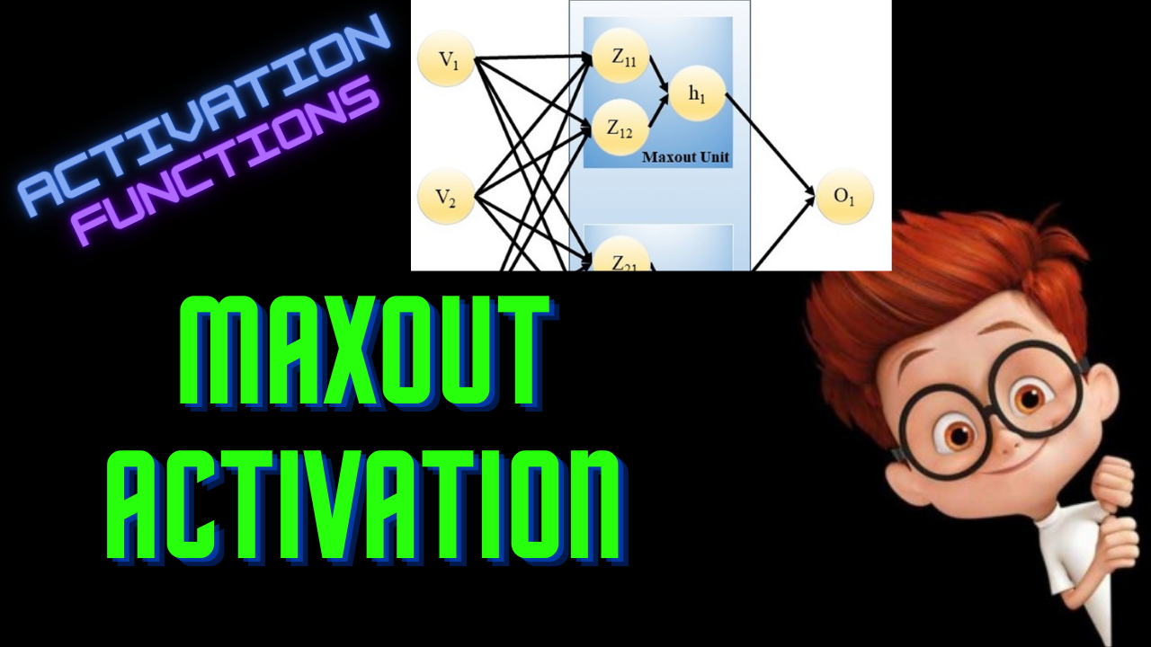

Slide 2
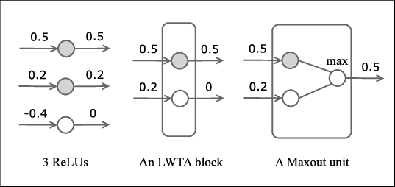
Illustration

Slide 3
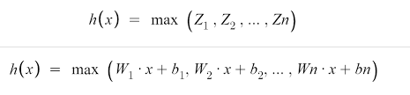
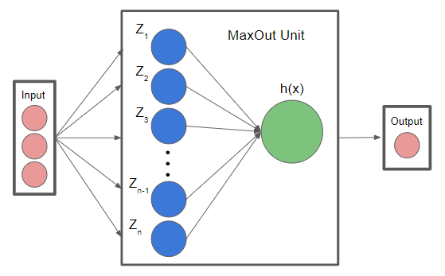
Maxout

Slide 4
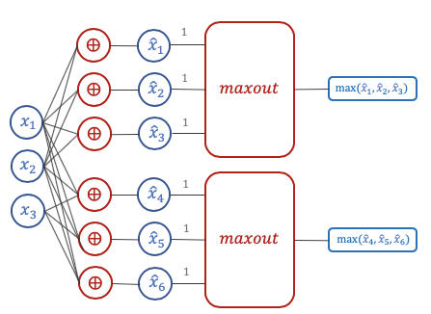
Illustration

Slide 5
Network - (5,4,2)
Input Hidden Output

Slide 6
Network - (5,4,2)
Input Hidden Output
1 output
Maxout

Slide 7
Network - (5,4,2)
2 outputs
Input Hidden Output

Slide 8
Network - (5,4,2)
Input Hidden Output
4 outputs
Number of outputs = Number of Groups

Slide 9
Network - (5,4,2)
Input Hidden Output

Slide 10


Notation
j = 1
k = 3
j = 2
i = 1
j = 3
i = 2
i = 3
i - Index for outputs/groups
j - Index for neurons in a group
k - Number of neurons in a group
i = 4

Slide 11
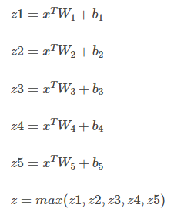
Example
If k=5
1 Maxout unit

Slide 12
Example - ReLU
Input - [2,5]
Weights - [4,5]
Biases - [4]
Batch size = 2
Input features = 5
Hidden neurons = 4

Slide 13
Example - Maxout
Input - [2,5]
Weights - [12,5]
Biases - [12]
Z - [2,12] - [2,4,3]
O = max(Z, axis=2) - [2,4]

Slide 14
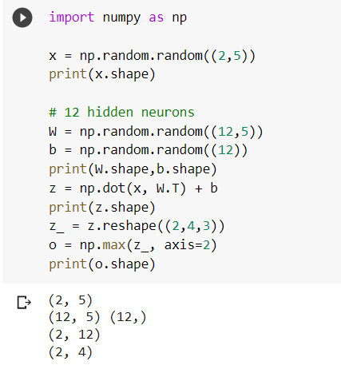
Implementation

Slide 15
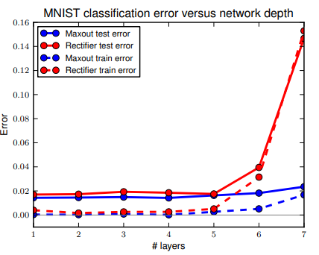
Advantages
Universal Approximator
Can generalize ReLU and Leaky ReLU
Works better than ReLU

Slide 16
Drawbacks
Prone to overfitting
Used along with dropout regularization
Doubles the number of parameters compared to other activations

